Slide 1
Astro 331
Thermal Control Subsystem (TCS)
SMAD Ch 11.5

Slide 2
Lesson Objectives
Explain spacecraft thermal control functions
List and describe the sources of heat on a spacecraft and when they apply
Describe reflectivity, absorptivity, transmissivity, and emissivity
List and describe methods of spacecraft thermal control and distinguish between passive and active approaches
Identify conditions which lead to spacecraft worst case hot and worst case cold equilibrium temperatures
Calculate equilibrium temperatures for spacecraft

Slide 3
TCS Functions
Maintain all S/C components w/i their required temperature limits during all mission phases
Cold temp that a component must not go below
Hot temp that a component must not go above
Relevant temps:
Operating limits: component must remain within these temperature ranges while operating
if operational limits are exceeded, equipment could display out-of-tolerance behavior
Survival limits: component must remain within these temperature ranges at all times, even when not powered
if survival limits are exceeded, component could suffer permanent damage and potentially not turn on

Slide 4
Adapted from Designing Space Missions and Systems, Table 11-42

Slide 5
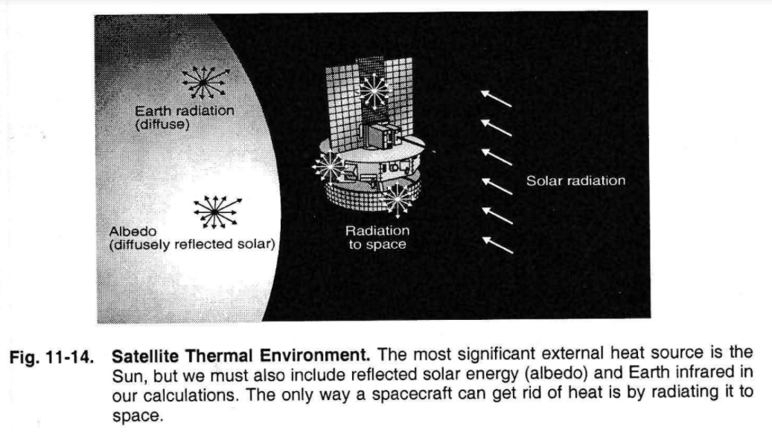
Thermal Radiation Environment

Slide 6
Sources of Heat on a S/C
Direct Solar:
Varies with 1/r² with distance from Sun
base value (1367 W/m²) is same as solar flux for solar array calcs
Albedo: solar energy reflected off surface of Earth
depends on reflective properties of particular part of Earth
because there tend to be more snow/ice near poles, they tend to have a higher reflectivity
Earth IR: thermal energy originating from Earth
Tends to emit more radiation closer to equator and less at poles
Internal Heat generation onboard S/C
Upper limit is total S/C power excluding that which is transmitted (ie communications)

Slide 7
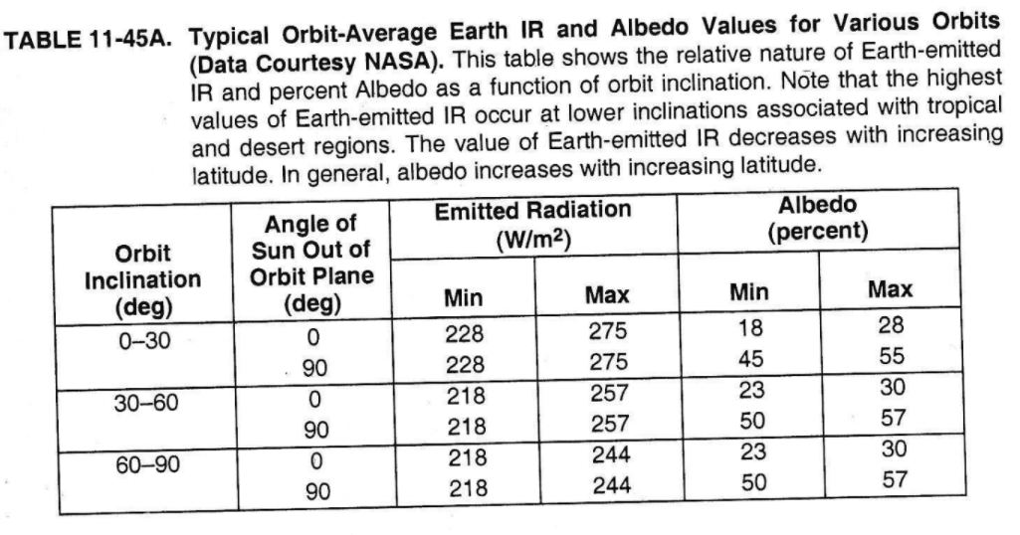

Slide 8
Methods of Heat Transfer
Three ways to move heat
Conduction*: thermal power transfer through matter in absence of fluid motion
Convection*: thermal power transfer btw flowing fluid and a solid surface
Radiation: thermal power transfer via electromagnetic waves
*Can move heat around S/C, but not outside of S/C

Slide 9
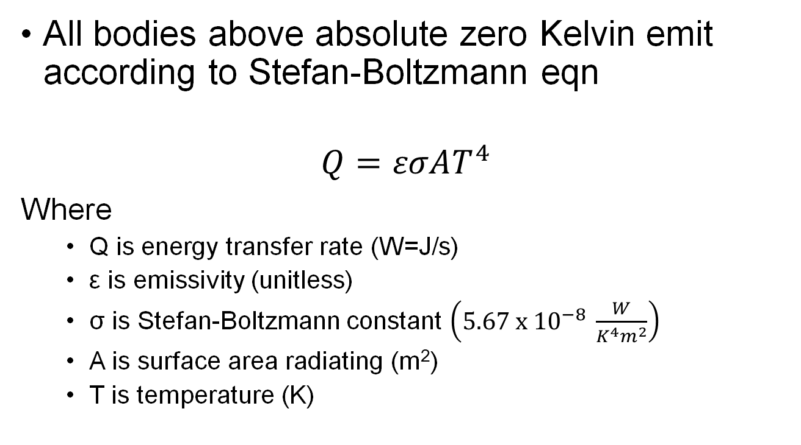
Heat Emission
All bodies above absolute zero Kelvin emit according to Stefan-Boltzmann eqn
$$Q=εσAT^{4}$$
Where
Q is energy transfer rate (W=J/s)
ε is emissivity (unitless)
σ is Stefan-Boltzmann constant $\left(5.67 x {10}^{−8} \frac{W}{K^{4}m^{2}}\right)$
A is surface area radiating (m²)
T is temperature (K)

Slide 10
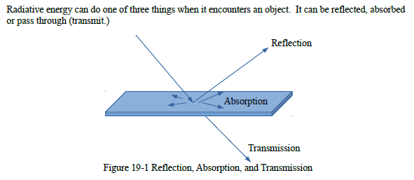
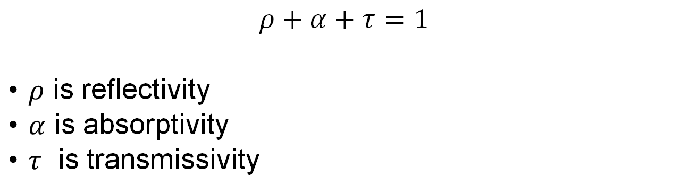
Thermal Equilibrium
$$ρ+α+τ=1$$
$ρ$ is reflectivity
$α$ is absorptivity
$τ$ is transmissivity

Slide 11
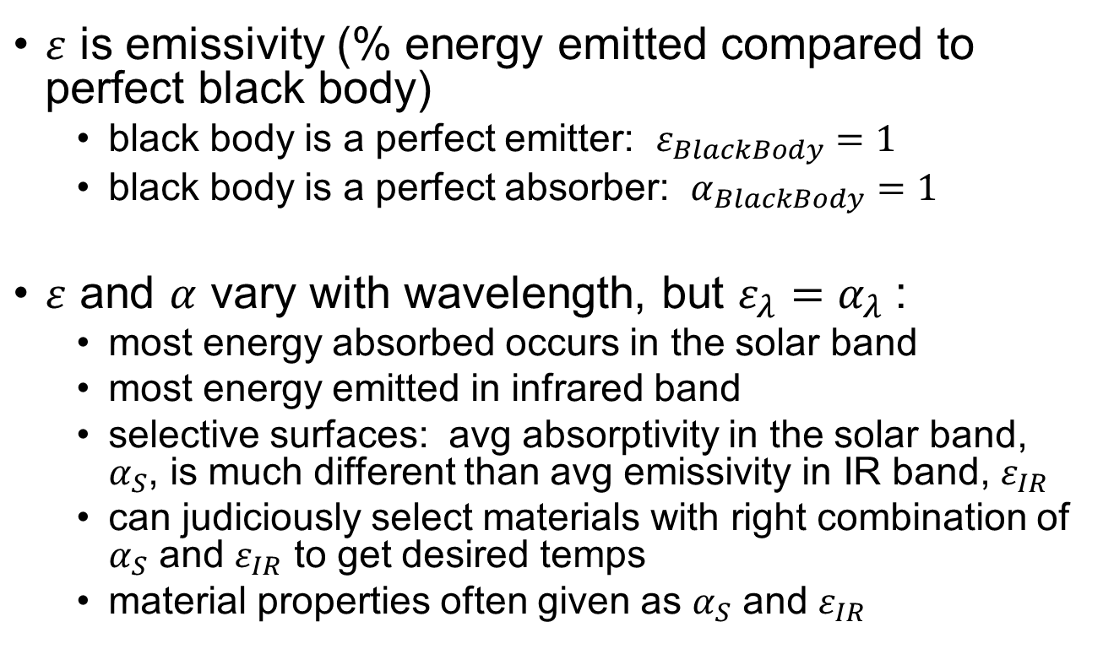
Emissivity
$ε$ is emissivity (% energy emitted compared to perfect black body)
black body is a perfect emitter: $ε_{BlackBody}=1$
black body is a perfect absorber: $α_{BlackBody}=1$
$ε$ and $α$ vary with wavelength, but $ε_{λ}=α_{λ}$:
most energy absorbed occurs in the solar band
most energy emitted in infrared band
selective surfaces: avg absorptivity in the solar band, $α_{S}$, is much different than avg emissivity in IR band, $ε_{IR}$
can judiciously select materials with right combination of $α_{S}$ and $ε_{IR}$ to get desired temps
material properties often given as $α_{S}$ and $ε_{IR}$

Slide 12
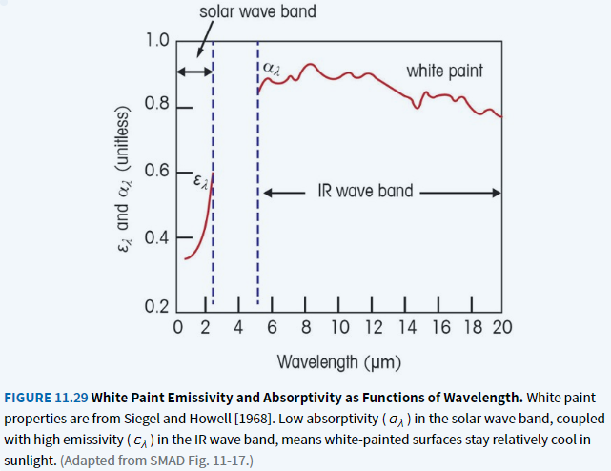
Emissivity & Absorptivity Vary with Wavelength
Designing Space Missions and Systems, Figure 11.29

Slide 13
Wertz and Larson, SMAD 3rd Edition, Table 11-44
Different editions of SMAD have slightly different tables

Slide 14
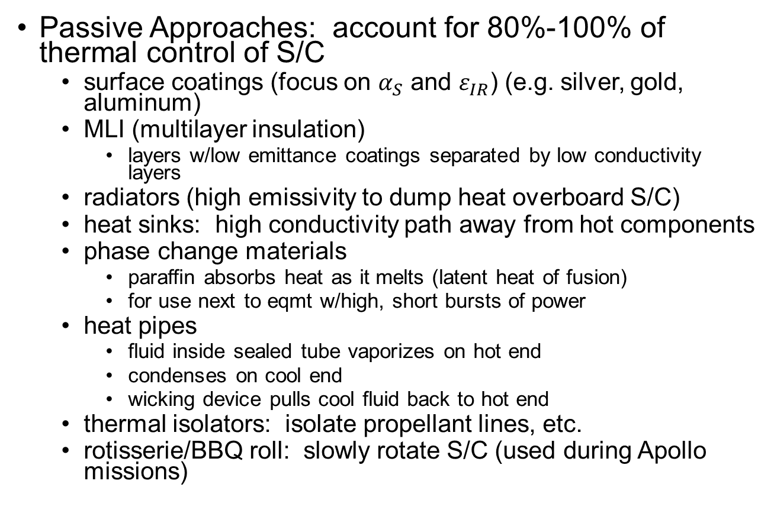
Methods of Thermal Control
Passive Approaches: account for 80%-100% of thermal control of S/C
surface coatings (focus on $α_{S}$ and $ε_{IR}$) (e.g. silver, gold, aluminum)
MLI (multilayer insulation)
layers w/low emittance coatings separated by low conductivity layers
radiators (high emissivity to dump heat overboard S/C)
heat sinks: high conductivity path away from hot components
phase change materials
paraffin absorbs heat as it melts (latent heat of fusion)
for use next to eqmt w/high, short bursts of power
heat pipes
fluid inside sealed tube vaporizes on hot end
condenses on cool end
wicking device pulls cool fluid back to hot end
thermal isolators: isolate propellant lines, etc.
rotisserie/BBQ roll: slowly rotate S/C (used during Apollo missions)

Slide 15
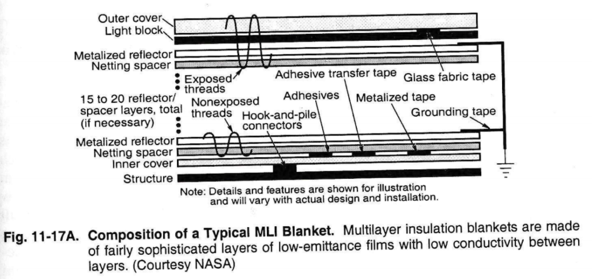

Slide 16
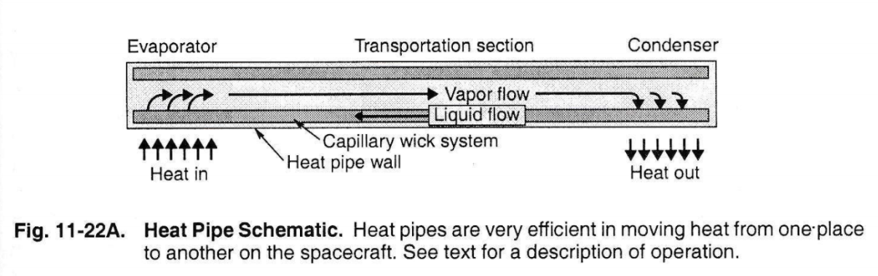

Slide 17
Methods of Thermal Control
Active Approaches:
louvers: insulated blades variably cover radiators (changes effective emissivity)
electric heaters
thermoelectric coolers
expendable cooling systems: stored cryogens absorb heat are then vented to space
active refrigeration: remove heat from hot components and transport to radiators

Slide 18
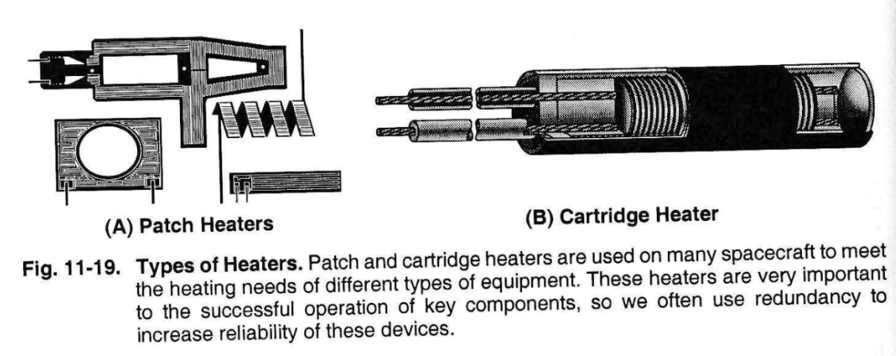

Slide 19
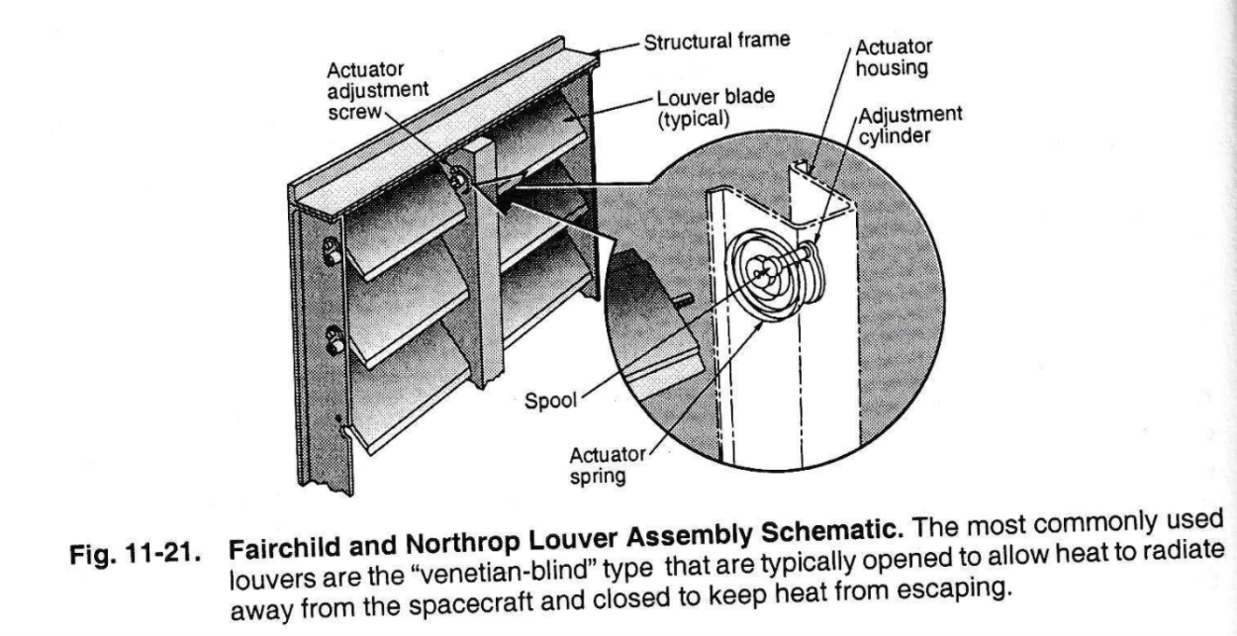

Slide 20
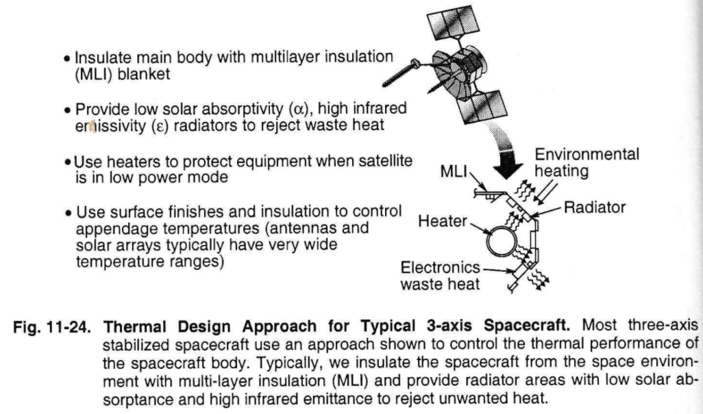
Example of Full TCS Approach

Slide 21
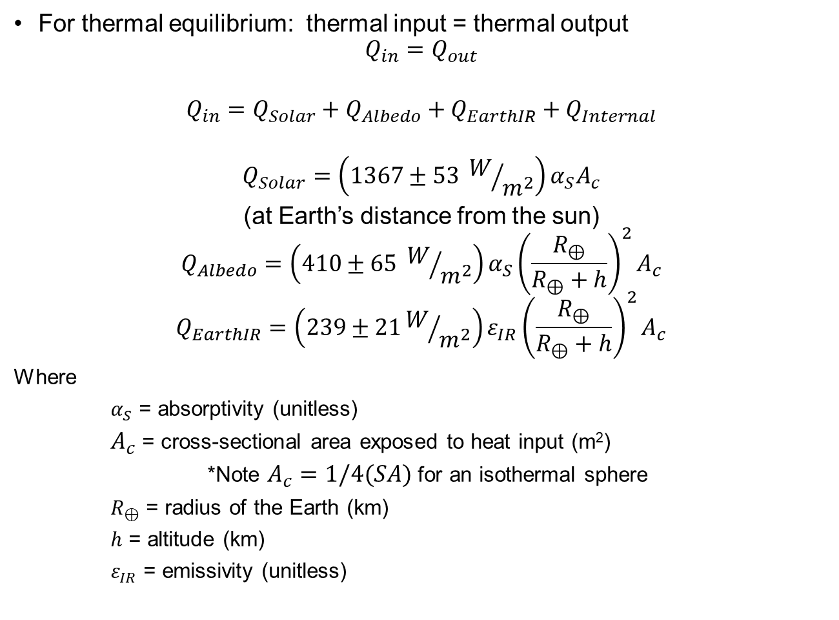
Thermal Equilibrium
For thermal equilibrium: thermal input = thermal output
$$Q_{in}=Q_{out}$$
$$Q_{in}=Q_{Solar}+Q_{Albedo}+Q_{EarthIR}+Q_{Internal}$$
$$Q_{Solar}=\left(1367±53 W/{m^{2}}\right)α_{S}A_{c}$$
(at Earth’s distance from the sun)
$$Q_{Albedo}=\left(410±65 W/{m^{2}}\right)α_{S}{\left(\frac{R_{⊕}}{R_{⊕}+h}\right)}^{2}A_{c}$$
$$Q_{EarthIR}=\left(239±21W/{m^{2}}\right)ε_{IR}{\left(\frac{R_{⊕}}{R_{⊕}+h}\right)}^{2}A_{c}$$
Where
$α_{S}$ = absorptivity (unitless)
$A_{c}$ = cross-sectional area exposed to heat input (m²)
*Note $A_{c}=1/4(SA)$ for an isothermal sphere
$R_{⊕}$ = radius of the Earth (km)
$h$ = altitude (km)
$ε_{IR}$ = emissivity (unitless)

Slide 22
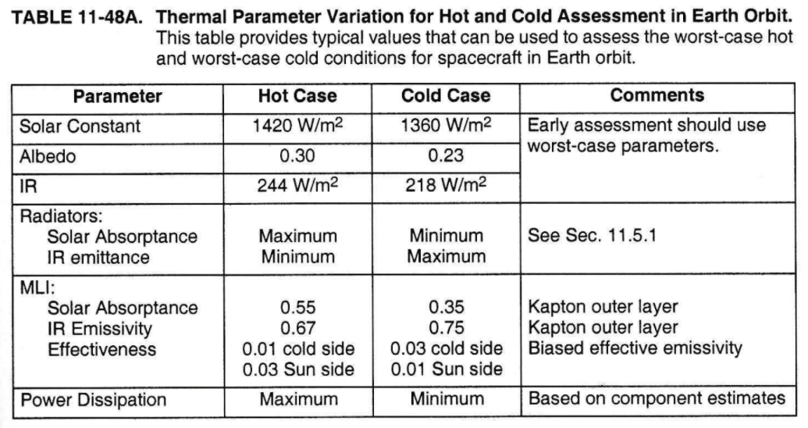
Worst Case Hot & Cold
Where does worst case hot & cold occur during each orbit?
Worst-case hot: S/C in direct sun (angle of incidence = 0°)
Worst-case cold: S/C just about to exit eclipse (longest time in eclipse)

Slide 23
Calculation Approach
Model S/C and deployed solar arrays separately
Model worst-case hot and worst-case cold
Model S/C as isothermal sphere, radiating in all directions, receiving heat on a projected side
Model solar arrays as flat plates
Front and back of arrays have different emissivity and absorptivity values

Slide 24
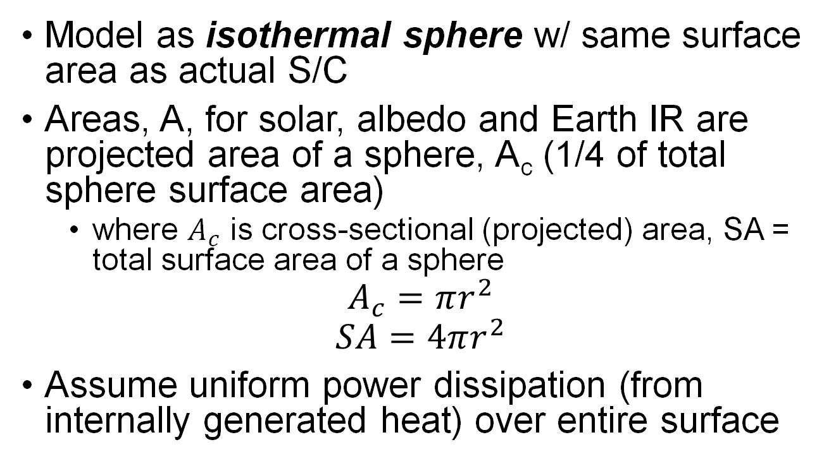
Spacecraft Body (1/3)
Model as isothermal sphere w/ same surface area as actual S/C
Areas, A, for solar, albedo and Earth IR are projected area of a sphere, A_{c} (1/4 of total sphere surface area)
where $A_{c}$ is cross-sectional (projected) area, SA = total surface area of a sphere
$$A_{c}=πr^{2}$$
$$SA=4πr^{2}$$
Assume uniform power dissipation (from internally generated heat) over entire surface

Slide 25
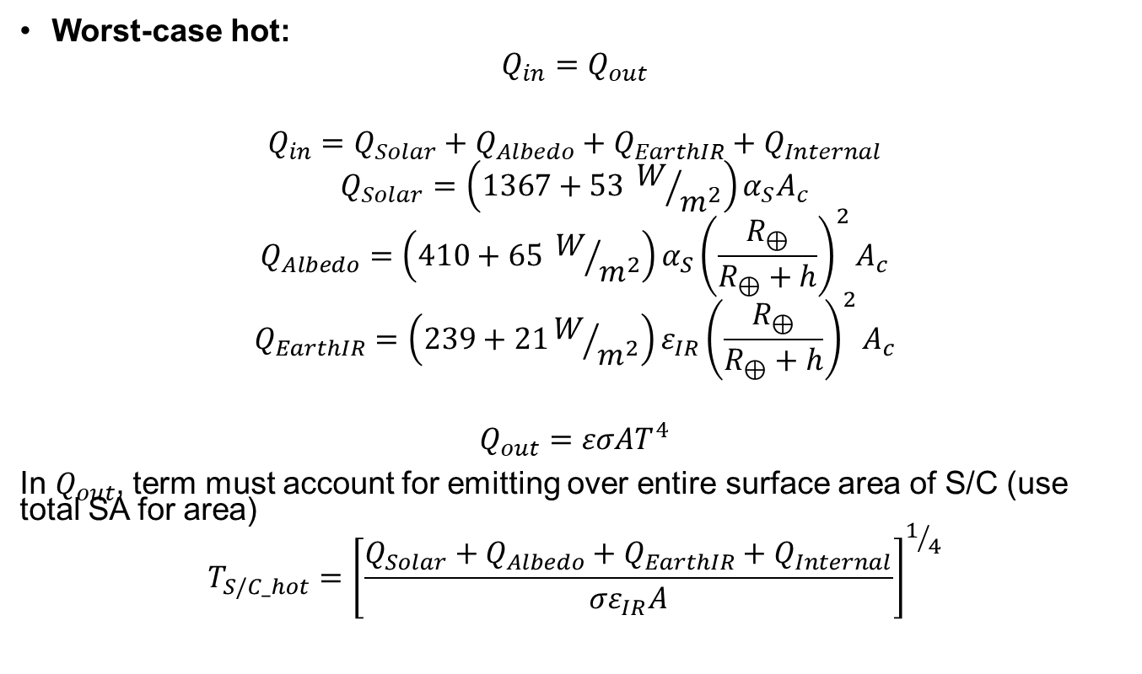
Spacecraft Body (2/3)
Worst-case hot:
$$Q_{in}=Q_{out}$$
$$Q_{in}=Q_{Solar}+Q_{Albedo}+Q_{EarthIR}+Q_{Internal}$$
$$Q_{Solar}=\left(1367+53 W/{m^{2}}\right)α_{S}A_{c}$$
$$Q_{Albedo}=\left(410+65 W/{m^{2}}\right)α_{S}{\left(\frac{R_{⊕}}{R_{⊕}+h}\right)}^{2}A_{c}$$
$$Q_{EarthIR}=\left(239+21W/{m^{2}}\right)ε_{IR}{\left(\frac{R_{⊕}}{R_{⊕}+h}\right)}^{2}A_{c}$$
$$Q_{out}=εσAT^{4}$$
In $Q_{out}$, term must account for emitting over entire surface area of S/C (use total SA for area)
$$T_{S/C_hot}={\left[\frac{Q_{Solar}+Q_{Albedo}+Q_{EarthIR}+Q_{Internal}}{σε_{IR}A}\right]}^{1/4}$$

Slide 26
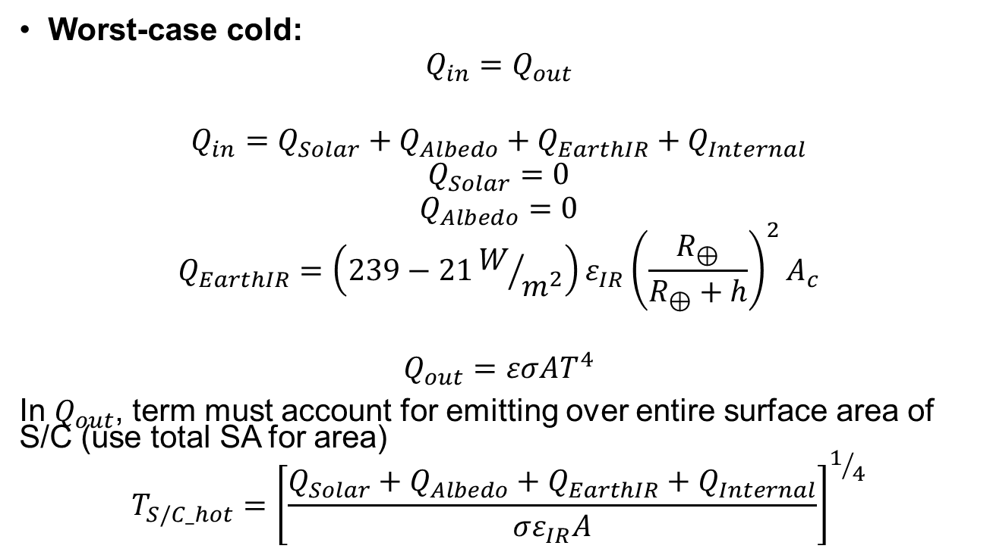
Spacecraft Body (3/3)
Worst-case cold:
$$Q_{in}=Q_{out}$$
$$Q_{in}=Q_{Solar}+Q_{Albedo}+Q_{EarthIR}+Q_{Internal}$$
$$Q_{Solar}=0$$
$$Q_{Albedo}=0$$
$$Q_{EarthIR}=\left(239−21W/{m^{2}}\right)ε_{IR}{\left(\frac{R_{⊕}}{R_{⊕}+h}\right)}^{2}A_{c}$$
$$Q_{out}=εσAT^{4}$$
In $Q_{out}$, term must account for emitting over entire surface area of S/C (use total SA for area)
$$T_{S/C_hot}={\left[\frac{Q_{Solar}+Q_{Albedo}+Q_{EarthIR}+Q_{Internal}}{σε_{IR}A}\right]}^{1/4}$$

Slide 27
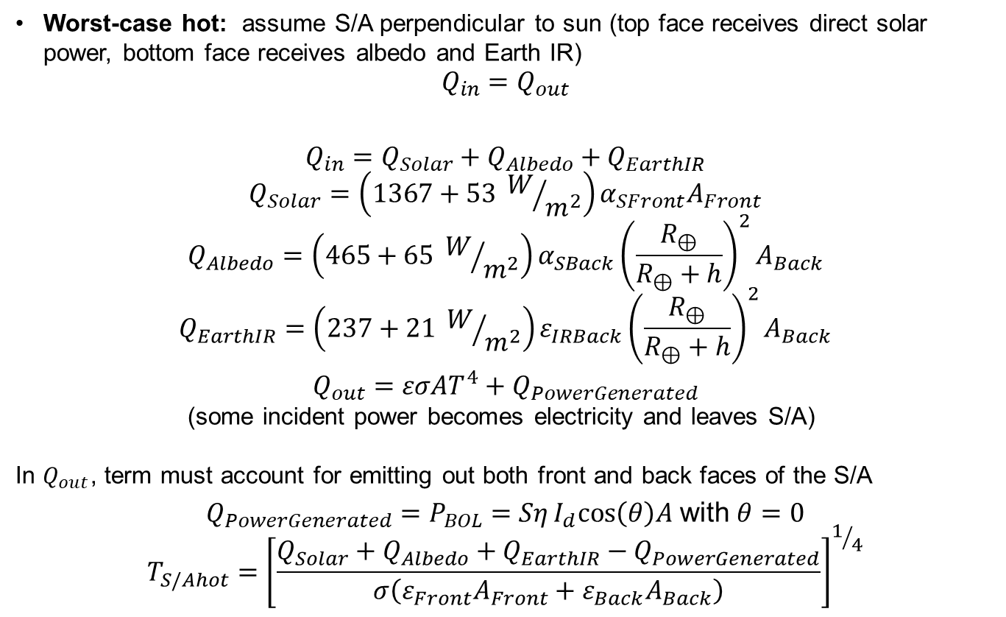
Deployed Solar Arrays (1/2)
Worst-case hot: assume S/A perpendicular to sun (top face receives direct solar power, bottom face receives albedo and Earth IR)
$$Q_{in}=Q_{out}$$
$$Q_{in}=Q_{Solar}+Q_{Albedo}+Q_{EarthIR}$$
$$Q_{Solar}=\left(1367+53 W/{m^{2}}\right)α_{SFront}A_{Front}$$
$$Q_{Albedo}=\left(465+65 W/{m^{2}}\right)α_{SBack}{\left(\frac{R_{⊕}}{R_{⊕}+h}\right)}^{2}A_{Back}$$
$$Q_{EarthIR}=\left(237+21 W/{m^{2}}\right)ε_{IRBack}{\left(\frac{R_{⊕}}{R_{⊕}+h}\right)}^{2}A_{Back}$$
$Q_{out}=εσAT^{4}+Q_{PowerGenerated}$
(some incident power becomes electricity and leaves S/A)
In $Q_{out}$, term must account for emitting out both front and back faces of the S/A
$Q_{PowerGenerated}=P_{BOL}=SηI_{d}cos\left(θ\right)A$ with $θ=0$
$$T_{S/Ahot}={\left[\frac{Q_{Solar}+Q_{Albedo}+Q_{EarthIR}−Q_{PowerGenerated}}{σ\left(ε_{Front}A_{Front}+ε_{Back}A_{Back}\right)}\right]}^{1/4}$$

Slide 28
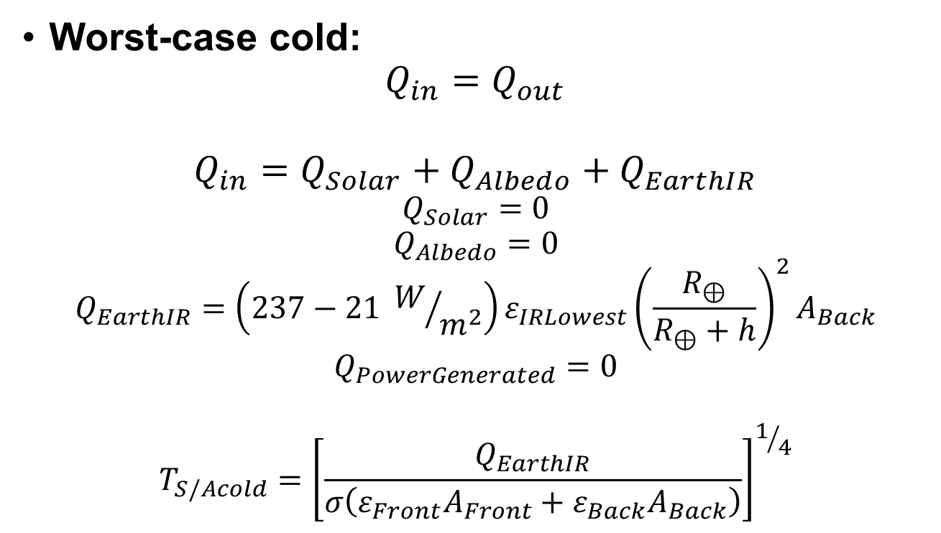
Deployed Solar Arrays (2/2)
Worst-case cold:
$$Q_{in}=Q_{out}$$
$$Q_{in}=Q_{Solar}+Q_{Albedo}+Q_{EarthIR}$$
$$Q_{Solar}=0$$
$$Q_{Albedo}=0$$
$$Q_{EarthIR}=\left(237−21 W/{m^{2}}\right)ε_{IRLowest}{\left(\frac{R_{⊕}}{R_{⊕}+h}\right)}^{2}A_{Back}$$
$$Q_{PowerGenerated}=0$$
$$T_{S/Acold}={\left[\frac{Q_{EarthIR}}{σ\left(ε_{Front}A_{Front}+ε_{Back}A_{Back}\right)}\right]}^{1/4}$$

Slide 29
Example
Given:
h = 700 km, circular orbit
Cube-shaped satellite: 2.5 m² per side
Internal S/C power: 450-500 W
Deployed solar arrays are 7 m²
S/As produce 1350 W at BOL
Find: Hot and cold equilibrium temps for spacecraft body and solar arrays
 | α_{S} | ε_{IR}
S/C | 0.6 | 0.8
S/A_{Front} | 0.805 | 0.825
S/A_{Back} | 0.975 | 0.874

Slide 30
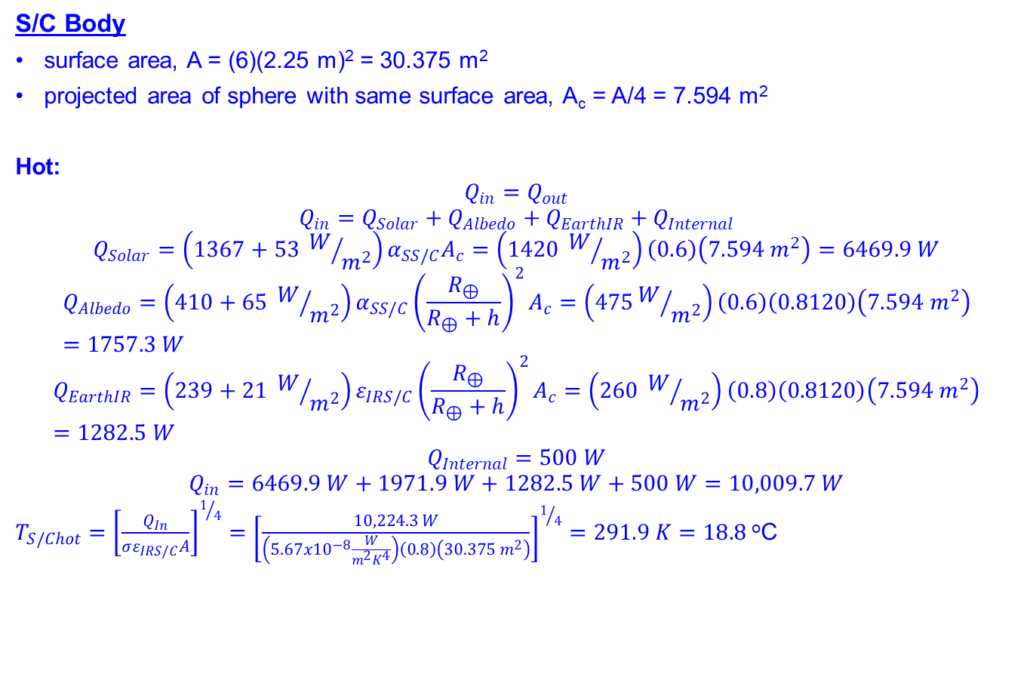
Solution (1/4)
S/C Body
surface area, A = (6)(2.25 m)² = 30.375 m²
projected area of sphere with same surface area, A_{c} = A/4 = 7.594 m²
Hot:
$$Q_{in}=Q_{out}$$
$$Q_{in}=Q_{Solar}+Q_{Albedo}+Q_{EarthIR}+Q_{Internal}$$
$$Q_{Solar}=\left(1367+53 W/{m^{2}}\right)α_{SS/C}A_{c}=\left(1420 W/{m^{2}}\right)\left(0.6\right)\left(7.594 m^{2}\right)=6469.9 W$$
$$Q_{Albedo}=\left(410+65 W/{m^{2}}\right)α_{SS/C}{\left(\frac{R_{⊕}}{R_{⊕}+h}\right)}^{2}A_{c}=\left(475W/{m^{2}}\right)\left(0.6\right)\left(0.8120\right)\left(7.594 m^{2}\right)=1757.3 W$$
$$Q_{EarthIR}=\left(239+21 W/{m^{2}}\right)ε_{IRS/C}{\left(\frac{R_{⊕}}{R_{⊕}+h}\right)}^{2}A_{c}=\left(260 W/{m^{2}}\right)\left(0.8\right)\left(0.8120\right)\left(7.594 m^{2}\right)=1282.5 W$$
$$Q_{Internal}=500 W$$
$$Q_{in}=6469.9 W+1971.9 W+1282.5 W+500 W=10,009.7 W$$
$T_{S/Chot}={\left[\frac{Q_{In}}{σε_{IRS/C}A}\right]}^{1/4}={\left[\frac{10,224.3 W}{\left(5.67x{10}^{−8}\frac{W}{m^{2}K^{4}}\right)\left(0.8\right)\left(30.375 m^{2}\right)}\right]}^{1/4}=291.9 K=18.8$ºC

Slide 31

Solution (2/4)
S/C Body
Cold:
$$Q_{in}=Q_{Solar}+Q_{Albedo}+Q_{EarthIR}+Q_{Internal}$$
$$Q_{EarthIR}=\left(239−21 W/{m^{2}}\right)ε_{IRS/C}{\left(\frac{R_{⊕}}{R_{⊕}+h}\right)}^{2}A_{c}=\left(218 W/{m^{2}}\right)\left(0.8\right)\left(0.8120\right)\left(7.594 m^{2}\right)=1075.4 W$$
$$Q_{Internal}=450 W$$
$$Q_{in}=0+0+1075.4 W+450 W=1525.4 W$$
$T_{S/Ccold}={\left[\frac{Q_{In}}{σε_{IRS/C}A}\right]}^{1/4}={\left[\frac{1525.4 W}{\left(5.67x{10}^{−8}\frac{W}{m^{2}K^{4}}\right)\left(0.8\right)\left(30.375 m^{2}\right)}\right]}^{1/4}=182.4 K=−90.7$ºC

Slide 32
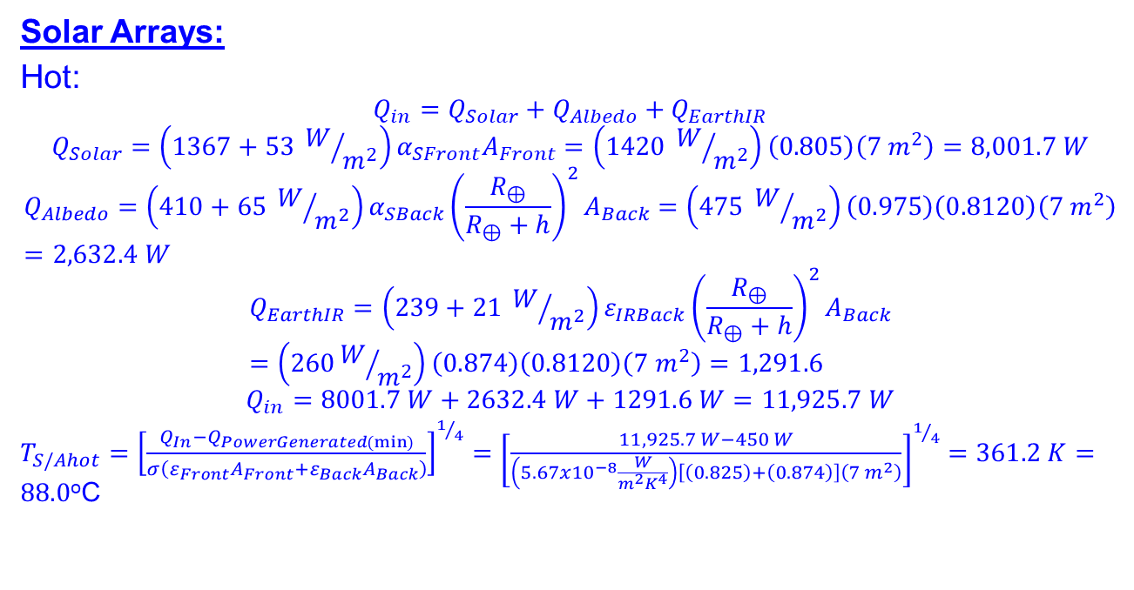
Solution (3/4)
Solar Arrays:
Hot:
$$Q_{in}=Q_{Solar}+Q_{Albedo}+Q_{EarthIR}$$
$$Q_{Solar}=\left(1367+53 W/{m^{2}}\right)α_{SFront}A_{Front}=\left(1420 W/{m^{2}}\right)\left(0.805\right)\left(7 m^{2}\right)=8,001.7 W$$
$$Q_{Albedo}=\left(410+65 W/{m^{2}}\right)α_{SBack}{\left(\frac{R_{⊕}}{R_{⊕}+h}\right)}^{2}A_{Back}=\left(475 W/{m^{2}}\right)\left(0.975\right)\left(0.8120\right)\left(7 m^{2}\right)=2,632.4 W$$
$$Q_{EarthIR}=\left(239+21 W/{m^{2}}\right)ε_{IRBack}{\left(\frac{R_{⊕}}{R_{⊕}+h}\right)}^{2}A_{Back}=\left(260W/{m^{2}}\right)\left(0.874\right)\left(0.8120\right)\left(7 m^{2}\right)=1,291.6$$
$$Q_{in}=8001.7 W+2632.4 W+1291.6 W=11,925.7 W$$
$T_{S/Ahot}={\left[\frac{Q_{In}−Q_{PowerGenerated(min)}}{σ\left(ε_{Front}A_{Front}+ε_{Back}A_{Back}\right)}\right]}^{1/4}={\left[\frac{11,925.7 W−450 W}{\left(5.67x{10}^{−8}\frac{W}{m^{2}K^{4}}\right)\left[\left(0.825\right)+\left(0.874\right)\right]\left(7 m^{2}\right)}\right]}^{1/4}=361.2 K=88.0$ºC

Slide 33
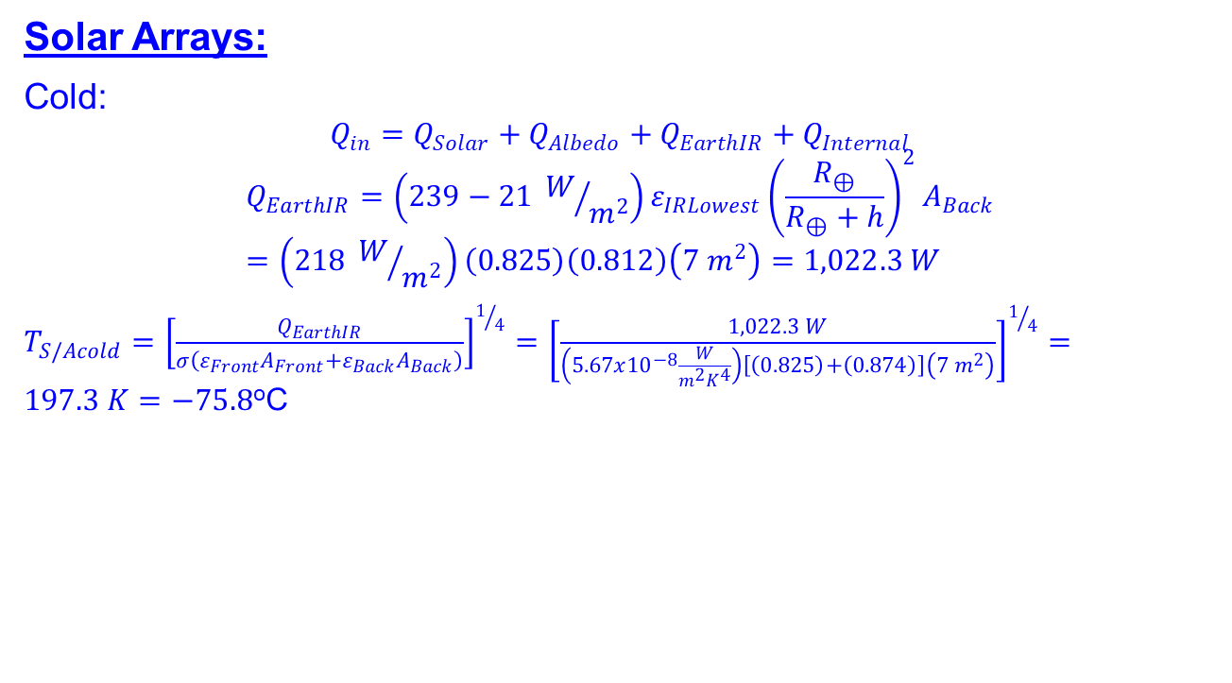
Solution (4/4)
Solar Arrays:
Cold:
$$Q_{in}=Q_{Solar}+Q_{Albedo}+Q_{EarthIR}+Q_{Internal}$$
$$Q_{EarthIR}=\left(239−21 W/{m^{2}}\right)ε_{IRLowest}{\left(\frac{R_{⊕}}{R_{⊕}+h}\right)}^{2}A_{Back}=\left(218 W/{m^{2}}\right)\left(0.825\right)\left(0.812\right)\left(7 m^{2}\right)=1,022.3 W$$
$T_{S/Acold}={\left[\frac{Q_{EarthIR}}{σ\left(ε_{Front}A_{Front}+ε_{Back}A_{Back}\right)}\right]}^{1/4}={\left[\frac{1,022.3 W}{\left(5.67x{10}^{−8}\frac{W}{m^{2}K^{4}}\right)\left[\left(0.825\right)+\left(0.874\right)\right]\left(7 m^{2}\right)}\right]}^{1/4}=197.3 K=−75.8$ºC

